Slide 1
Final
Figures

Slide 2
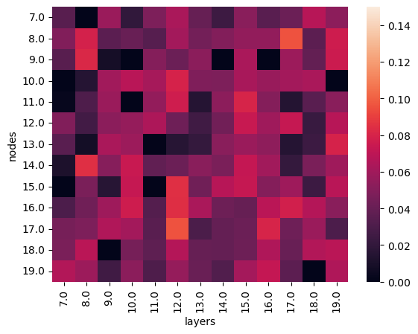
Neural Network
Here my neural network is looking at the relationship between ticks and fleas and recaptures in the field
There is a very low correlation between these three variables as the highest correlation was at 12, 17 and was only ~0.12
I chose to do this type of analysis because it clearly portrays the relationship between multiple variables and it is very easy to modify in order to better visualize and understand your data.

Slide 3
Predictor | Estimate | Std. Error | z value | p-value
(Intercept) | −2.9122 | NaN | NaN | NaN
T_Loadz | −9.4642 | NaN | NaN | NaN
Massz | −0.5496 | 0.3048 | −1.803 | 0.0713
Condition (ta) | 0.6614 | 0.5804 | 1.140 | 0.2545
Condition (td) | −0.2161 | 0.9993 | −0.216 | 0.8288
Condition (vc) | −0.5950 | 1.4958 | −0.398 | 0.6908
Condition (vc/md4) | −1.1803 | NaN | NaN | NaN
Condition (vc/md5) | 0.4370 | 1.8389 | 0.238 | 0.8122
Condition (vo) | −1.2697 | 1.3431 | −0.945 | 0.3445
Condition (vo/md4) | −38.0380 | NaN | NaN | NaN
Condition (vo/md6) | −0.3016 | 1.5506 | −0.194 | 0.8458
Conditional Model
This was the first part of my double hurdle model which unfortunately did not work very well as you can see from the NAN values
This is because many of the variables I was looking at had many 0 values which kept them from being processed well in this model
For the ones that did work there was no relationship between them and recaptures as you can see from the high p-values

Slide 4
Predictor | Estimate | Std. Error | z value | p-value
(Intercept) | −1.292 | 0.574 | −2.251 | 0.0244 *
T_Loadz | 0.502 | 0.320 | 1.569 | 0.1166
Massz | −0.158 | 0.447 | −0.353 | 0.7239
Condition (ta) | 0.507 | 0.710 | 0.714 | 0.4754
Condition (td) | 0.821 | 1.077 | 0.762 | 0.4459
Condition (vc) | −21.50 | 72,160 | 0.000 | 0.9998
Condition (vc/md4) | −28.97 | 1.72e6 | 0.000 | 1.0000
Condition (vc/md5) | −16.37 | 8,074 | −0.002 | 0.9984
Condition (vo) | 0.134 | 1.336 | 0.101 | 0.9199
Condition (vo/md4) | 0.865 | 1.470 | 0.588 | 0.5564
Condition (vo/md6) | −20.61 | 47,520 | 0.000 | 0.9997
Zero-Inflation Model
This was the second part of my double hurdle model
This type of model worked much better than the conditional model and that is because this type of model accounts for the zeros and is able to incorporate them well into the analysis
This is because zero-inflation models assume that the data has two parts, one with structural zeros and one with positive counts.
Although the data was able to be analyzed better in this model there are still no significant relationships between the predictors and recaptures as all p-values are above 0.05

